Slide 1


A mini project work on
Network System Monitoring
By
ABHIJITH D.A 1PI01IS001
MAHESH M.P. 1PI01IS042
- Under Guidance of
RAMYA B.K.

Slide 2
What is a Computer Network?
A computer network is an interconnected collection of autonomous computers.
Two computers are said to be interconnected if they are able to exchange information.
By requiring computer to be autonomous, the systems with clear master slave relationships are excluded.

Slide 3
Why a Computer Network?
The following fields involve the use of computer networks
Networks for Companies
Networks for People
Social Issues

Slide 4
Goal of Computer Network
Resource Sharing
High Reliability
Saving Money
Access to remote Information
Person-to-person Communication
Interactive Environment

Slide 5
Why do we need a Network System Monitor?
The cost involved in building a computer network is enormous.
The status of the system running in the network reflects the throughput of the network.
If any problem is detected in any system, based on the previous knowledge of the system, the system can be repaired or handled accordingly.

Slide 6
What does the Network System Monitor do?
The network system monitor does the following tasks.
Given a valid network address of a machine and a request, the monitor displays the system info based on the request data.

Slide 7
A Connection oriented service
Server
(connection-oriented protocol)
socket()
bind()
listen()
Client
accept()
socket()
blocks until connection
from client
connection establishment
connect()
data (request)
write()
read()
write()
data (reply)
read()

Slide 8

Hardware and Software Requirements
Hardware Requirements
  X86 based processors with minimum 166 MHz CPU
  Color/B/W Monitor
  Keyboard
  8MB Ram
Software Requirements
  Linux or Unix OS
  Text editor
  gcc or cc or g++ compiler

Slide 9
System Design
Design includes two parts
Server Part
Client Part

Slide 10
Server Part
The server serves the client. i.e.
any request by the client is served by the
Server.
the server registers itself and keeps waiting
for the client to send message.
on receipt of the message, the server
performs the work and sends back the
reply to the client.
Server runs even on termination of the client.

Slide 11
Client Part
The client requests the server to get its job done and blocks itself. On receival of the reply, the client unblocks and continues its function.
Provided the correct IP address the server has registered, the client program sends request for a particular system information to the corresponding server program running in that machine.
After the server responds to the request, the same is displayed on the terminal of the client.

Slide 12
Pseudo code of Server Machine. (Client Code)
Start
Start new connection.
    Accept IP Address.
    Read “choice” from user.
    Send “choice” to “Client Machine (Server Code).
    .
    . (Block / Wait state).
    .
    Receive “processed result” from Client Machine.
    Display Results.
End

Slide 13
Pseudo code of Client Machine. (Server Code)
Start
    Accept “Choice” from Server Machine.
    .
    . (Process the Required information).
    .
    Send “processed result” to Server Machine.
End

Slide 14
Applications
A system without any application is worth not existent. The following are the applications that where the “Network Monitoring System” is useful.
The network system information can be obtained at just a single click by a user.
The administrator can upgrade the network system by comparing the existing system resources with the one needed.
A record of the network system resources can be obtained, which can be used to debug any problems that may arise in the near future.

Slide 15

Bibliography
Richard Stevens, “ UNIX Network Programming”, volume 1
Richard Stevens.” Advanced Programming in Unix”
Andrew S. Tanenbaum, “Computer Networks”
Linux man pages.

Slide 16
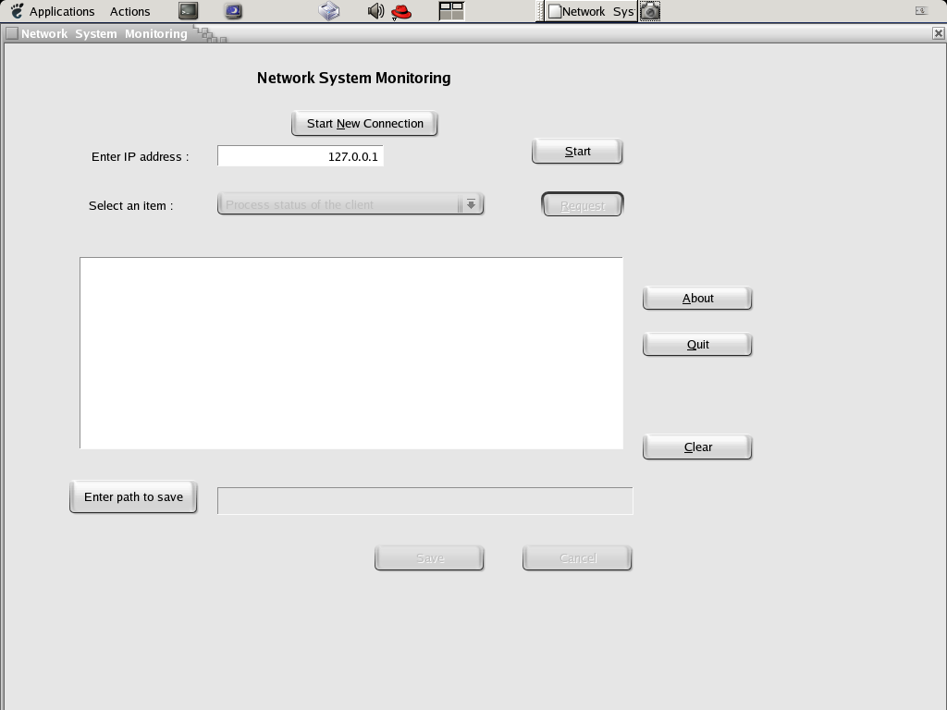
SNAPSHOT no.1

Slide 17
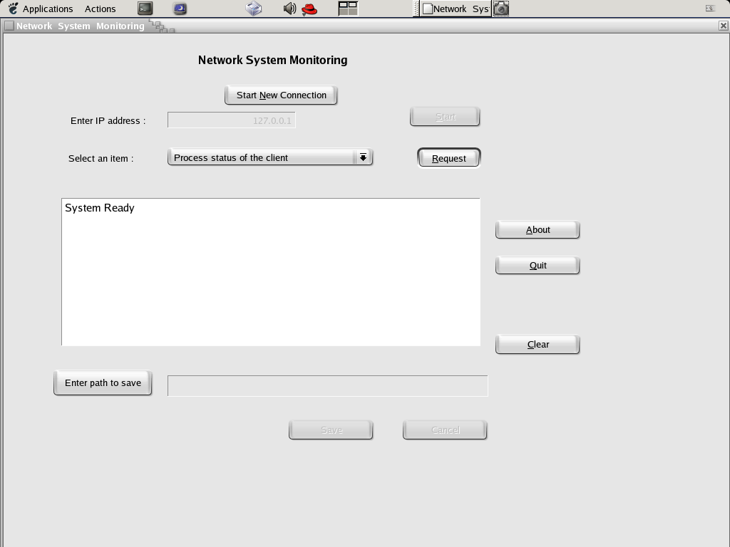
SNAPSHOT no.2

Slide 18
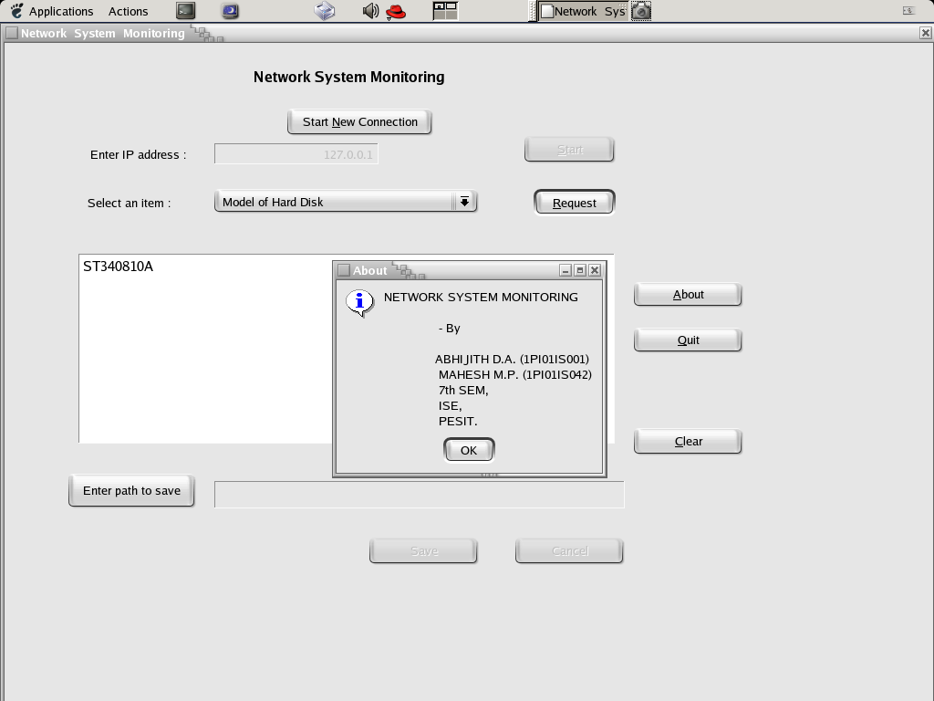
SNAPSHOT no.3

Slide 19
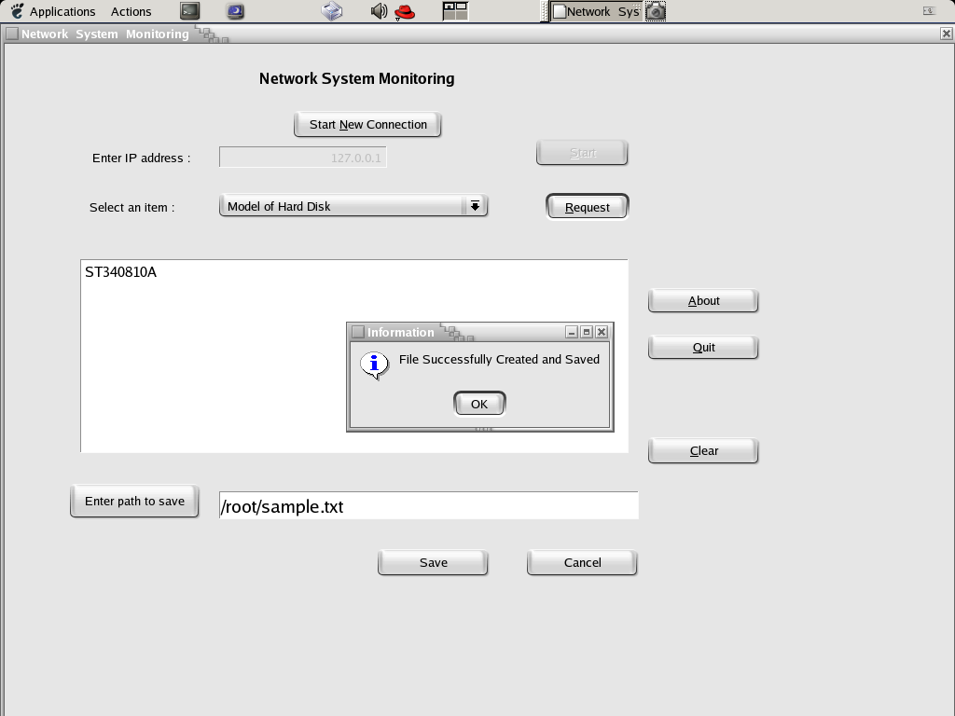
SNAPSHOT no.4

Slide 20
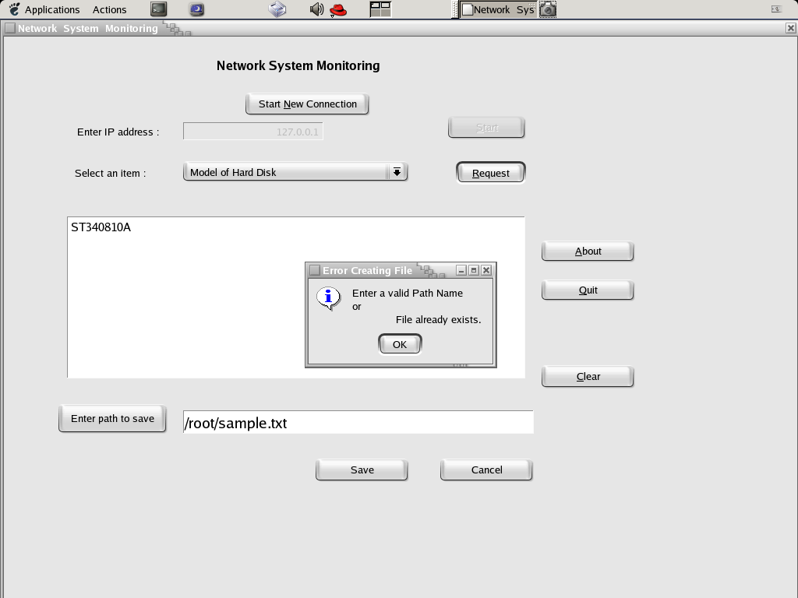
SNAPSHOT no.5

Slide 21
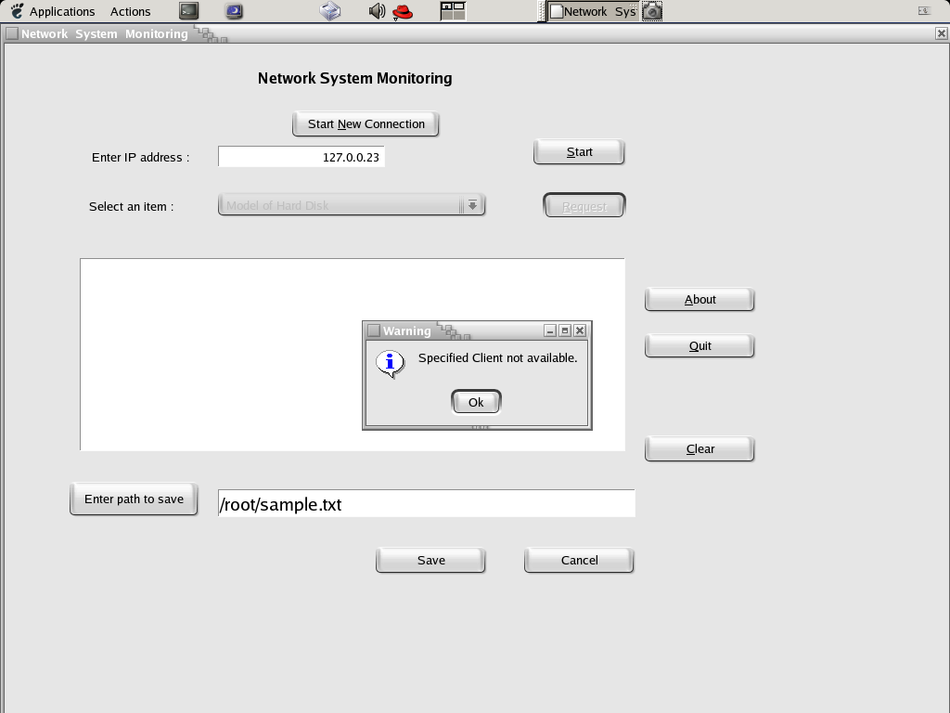
SNAPSHOT no.6

Slide 22

T H A N K Y O U

